Slide 1


Gender Recognition By Voice

Slide 2

MEET THE TEAM
Guide
Amey Admane
Neha Pandey
A-15
A-52
Prof. Sweta Jain
Pratik Yawalkar
Vaidehi Choudhari
A-62
A-78

Slide 3
Content
Problem Definition
Technologies Used
Timeline
Project Workflow
Analysis
Conclusion
References

Slide 4

Problem Definition
Identifying the gender using voice by training the Kaggle dataset using six machine learning models and comparing accuracy, precision, recall and F1 score of various models and suggesting the best model that can be used for gender recognition by voice.

Slide 5





Jupyter Notebook
Data Science Libraries
01
03
Kaggle Dataset
HTML, CSS, JS, Streamlit
04
02
Technologies Used
For implementing the project
Numpy, Matplotlib, Pandas, Seaborn
Dataset consisting of recorded voice sample for testing

Slide 6
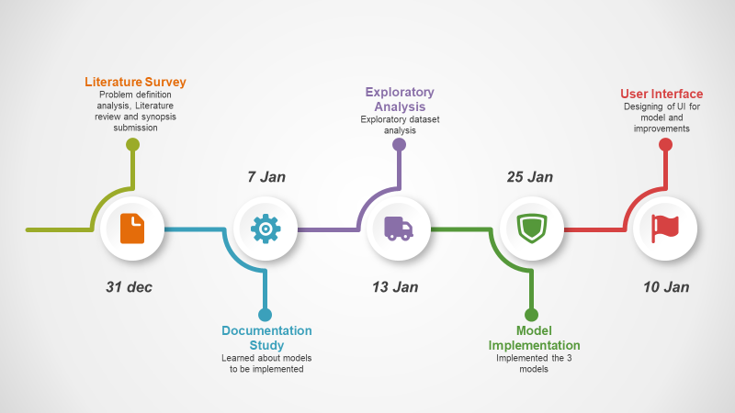
Timeline 15Dec - 10Jan

Slide 7

Project WorkFlow
A brief summary of our project’s workflow . . . . .

Slide 8
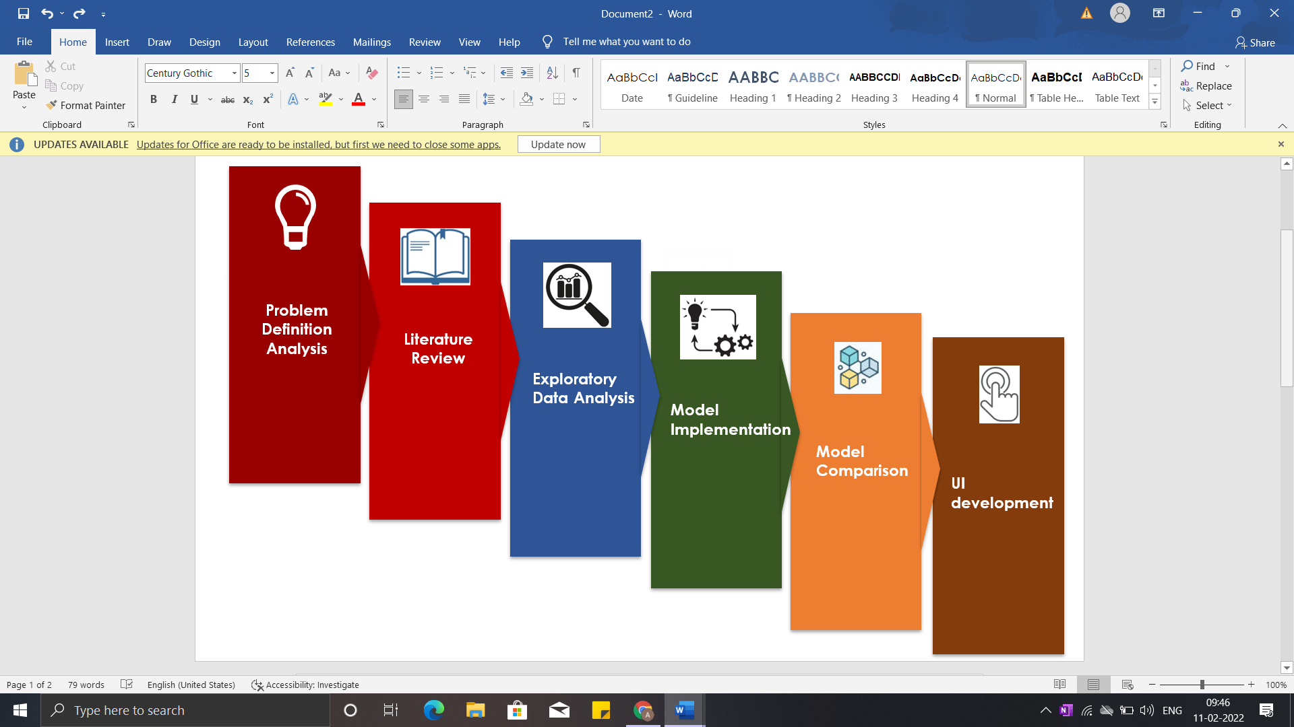

Slide 9
Voice(.CSV)
Dataset
Preprocessing
Checking for null values
Split Data
Train and test data
Build Classifier
Random Forest, Gradient Boosting, Decision Tree
Predict
Male
Female

Slide 10
Our Dataset
CSV file
Datatype: ‘Label’ => Object : other => float
Checking
for
Distribution of data
3168
Null values
Numeric or non-numeric values
Dependent values
1584
1584
Dataset (3168 x 21)
Plotting histogram
Correlation matrix using heatmap

Slide 11
Features
meanfreq
sd
median
Q25
Q75
IQR
skew
kurt
sp.ent
sfm
mode
centroid
peakf
meanfun
minfun
maxfun
meandom
mindom
maxdom
dfrange
modindx
label

Slide 12
Model Implementation
Random Forest
RandomForestClassifier
Decision Tree
DecisionTreeClassifier
Gradient Boosting
GradientBoostingClassifier

Slide 13
For every model . . .
Plotted confusion matrix and calculated Accuracy, precison, f1 and recall
Hyperparameter tuning using gridsearchcv library for each model
Plotted the bar chart representing the features that contributed the most in training the model
Using the results from correlation matrix, we dropped the features that were 90% correlated to each other and trained the model again.
The features that are highly correlated are
'Q25'
'centroid'
'dfrange'
'kurt'
'median'

Slide 14
User interface
Responsive and User friendly
Select the model of his/her choice.
Select features using which they want to train the model.
Set the size of testing dataset.
Represented all the scores visually using heatmap.
Using piechart, we have shown the correct and incorrect samples.
Plotted Important features using barplot.
Apply Model
Plot Pie Chart and Bar chart representing distribution of male and female in the dataset.
Using heatmap plot the Correlation matrix.
Univariate Analysis
Plots histogram of single feature selected by user
Bivariate Analysis
Plots a scatterplot of two feature selected by user
Explore Dataset

Slide 15
Correlation
ANALYSIS
Univariate
Bivariate

Slide 16
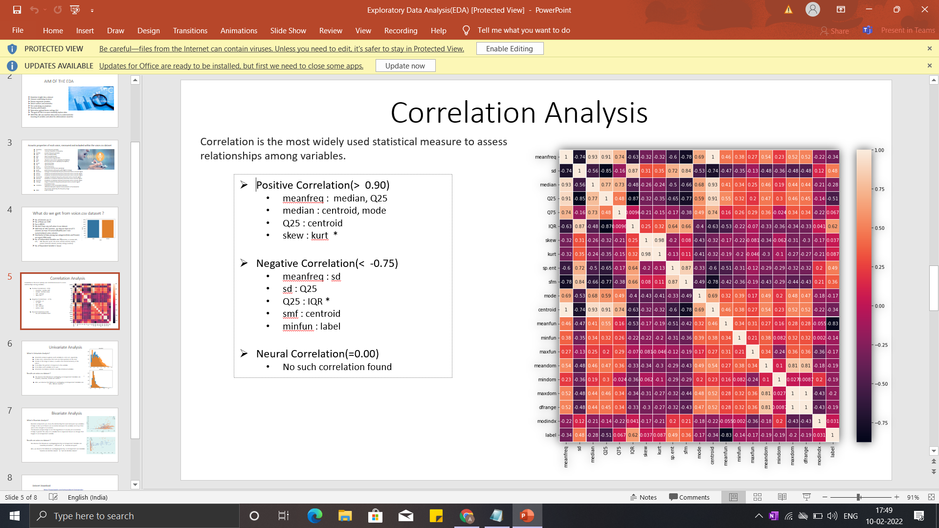
IQR and label have a strong positive correlation.
Spectral entropy is also quite highly correlated with the label.
meanfun is highly negatively correlated with the label.
Centroid and median have a high positive correlations .
Meanfreq and centroid are exactly same .Hence, their correlation is perfect 1.
sd is highly positively related to sfm and so is spent to sd.
kurt and skew are also highly correlated.
meanfreq is highly related to median as well as Q25.
IQR is highly correlated to sd.
self relation ie of a feature to itself is equal to 1.

Slide 17
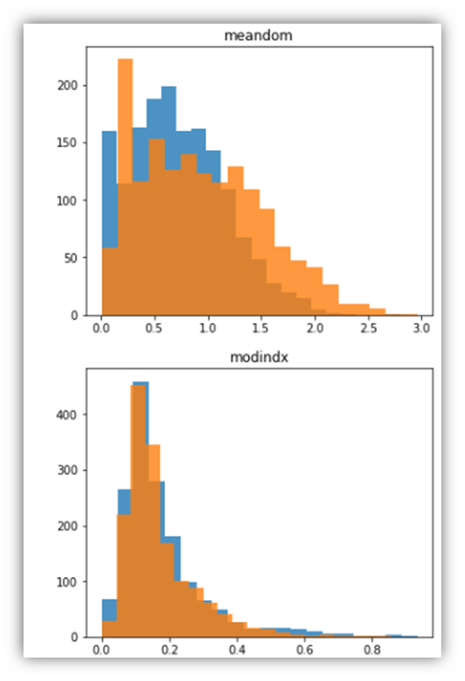
Univariate Analysis
Maximum overlapping on following features
modindx
mindom
median
maxfun
meandom
kurt
Minimum overlapping on following features
Q25
IQR
meanfun

Slide 18
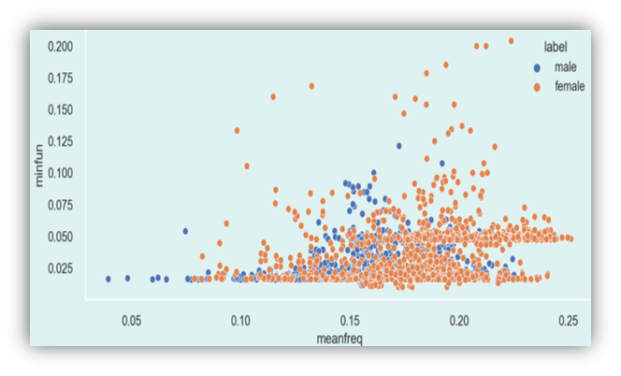
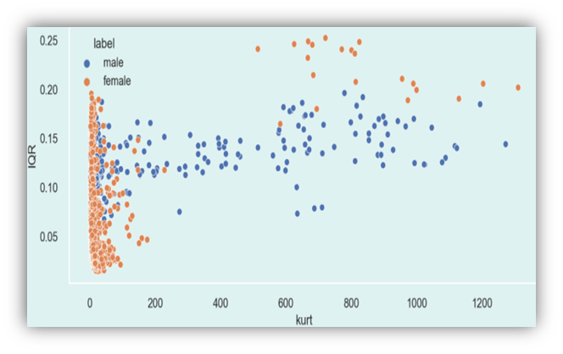
Bivariate Analysis
Minimum overlapping
meanfun and all other features
kurt and all other features
Maximum overlapping
meanfreq and minfun
Q75 and sd
maxdom and sp.ent

Slide 19
Comparison between Models
Decision Tree Vs Random Forest Vs Gradient Boosting

Slide 20
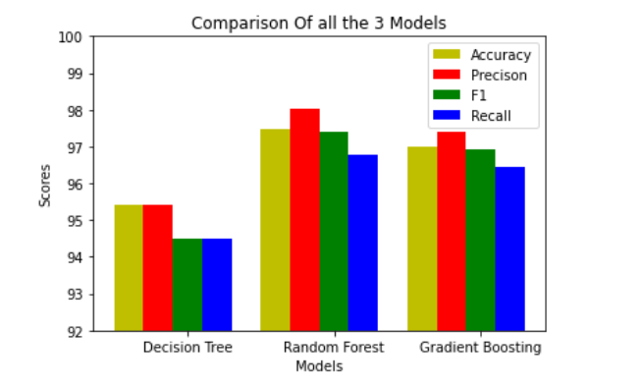
Comparison

Slide 21
Conclusion
We successfully recognized the gender of the recorded voice in the dataset given by applying the 3 ML models.
Out of all the 3 models implemented, Random Forest performed the best followed by Gradient Boosting with Decision Tree securing 3rd position.
Best case accuracy of Random forest is 97.47%,followed by gradient boosting with accuracy 97.00% and then decision tree with accuracy 95.42%.

Slide 22
References
https://www.kaggle.com/primaryobjects/voicegender
https://scikit-learn.org/
http://cs229.stanford.edu/proj2014/Kunyu%20Chen,%20Gender%20Identification%20by%20Voice.pdf
https://github.com/Kashika31/Gender-Recognition-by-Voice-Using-Machine-Learning/blob/master/Project%20Report.pdf
https://streamlit.io/
https://www.analyticsvidhya.com/blog/2020/04/confusion-matrix-machine-learning/
https://www.analyticsvidhya.com/blog/2021/08/decision-tree-algorithm/
https://www.analyticsvidhya.com/blog/2021/09/gradient-boosting-algorithm-a-complete-guide-for-beginners/
https://www.analyticsvidhya.com/blog/2021/06/understanding-random-forest/

